Slide 1
FLIGHT PRICE PREDICTION
BY
GIRIJA CHANDRA MOHAN

Slide 2
ACKNOWLEDGMENT
I would like to express my gratitude to my guide Khusboo Garg (SME, Flip Robo) for her constant guidance, encouragement and unconditional help towards the development of this Used Car Price Prediction project. She helped me whenever I got stuck somewhere in between. The project would have not been completed without her support and confidence.
Also, I have utilized a few external resources that helped me to complete the project. I ensured that I learn from the samples and modify things according to my project requirement.

Slide 3
All the external resources that were used in creating this project are listed below:
1) https://www.google.com/
2) https://www.youtube.com/
3) https://scikit-learn.org/stable/user_guide.html
4) https://github.com/
5) https://www.kaggle.com/
6) https://medium.com/
7) https://towardsdatascience.com/
8) https://www.analyticsvidhya.com/
9) https://www.expedia.com/

Slide 4
Business Problem Framing
Machine Learning is a field of technology developing with immense abilities and applications in automating tasks, where neither human intervention is needed nor explicit programming.
The power of ML is great that we can see its applications trending almost everywhere in our day-to-day lives. ML has solved many problems that existed earlier and have made businesses in the world progress to a great extent.
Today, we will go through one such practical problem and build a solution (model) on our own using ML.

Slide 5
DATA COLLECTION PHASE
I have collected from expedia website using web scrapping.
There are more than 5500 observations and 8 features including the target feature fare in dataset.
The dataset is in the form of CSV (Comma Separated Value) format and consists of 8 columns with 5590 number of records as explained below:
Airline_Names
Departure_Time
Arrival_Time
Flight_Duration
Source_Place
Destination_Place
Number_Of_Stops
Flight_Prices

Slide 6
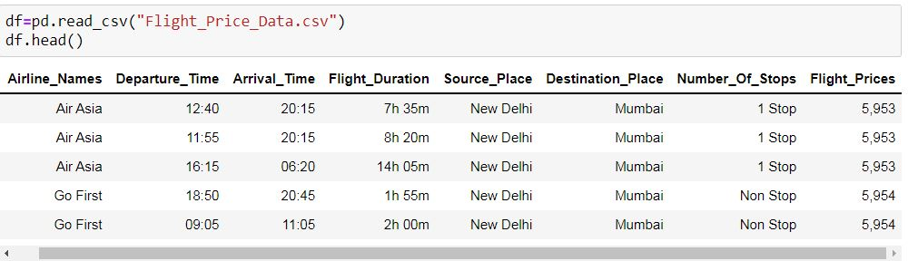

Slide 7
MODEL BUILDING PHASE
After collecting the data, you need to build a machine learning model. Before model building do all data pre-processing steps. Try different models with different hyper parameters and select the best model. Follow the complete life cycle of data science. Include all the steps below.
1. Data Cleaning
2. Exploratory Data Analysis
3. Data Pre-processing
4. Model Building
5. Model Evaluation
6. Selecting the best model

Slide 8
DATA PREPROCESSING
Importing the necessary dependencies and libraries.
Reading the CSV file and converted into data frame.
Checking the data dimensions for the original dataset.
Looking for null values and accordingly fill the missing data.
Checking the summary of the dataset.
Checking unique values.
Checking all the categorical columns in the dataset.

Slide 9
Visualizing each features using matplotlib and seaborn.
Performing encoding using the Label encoder on categorical features.
Checking for co-relation/multi-collinearity in a heatmap.
Checking for Outliers/Skewness using boxen plot and distribution plot.
Perform Scaling using Standard Scaler method.
Checking for the final dimension of dataset to confirm the input details.
Creating train test split and the best random state found in the range 1-100.

Slide 10
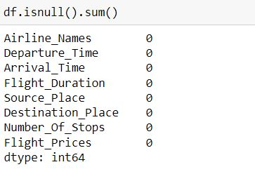
Check For Null Values
Null values in a dataset are to be filled with appropriate statistical values to get better results.

Slide 11
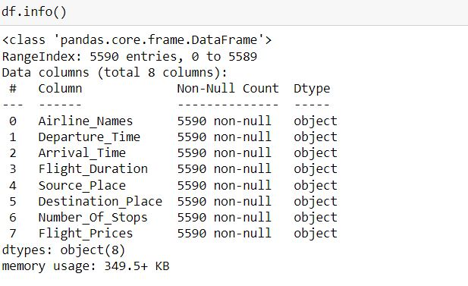
Handling the Data
All the features in the dataset are of object type, they are to be handled properly for further processing

Slide 12
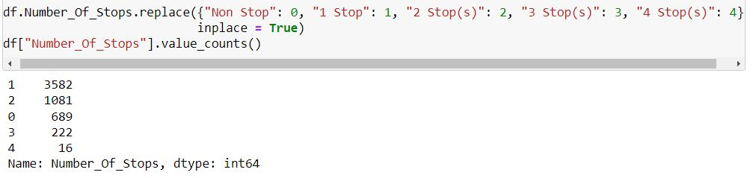
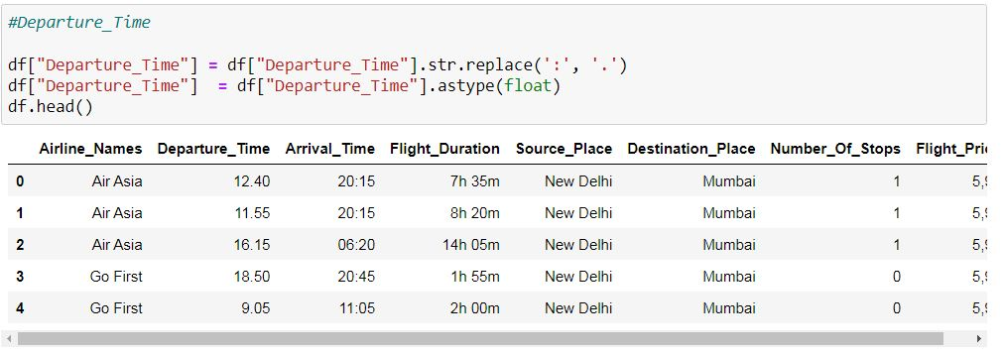
The various data processing performed on the data set is shown below with the code.

Slide 13
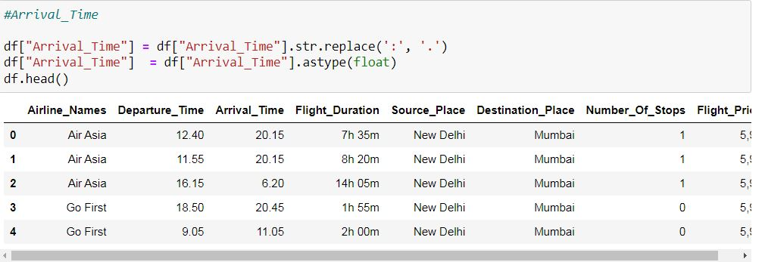
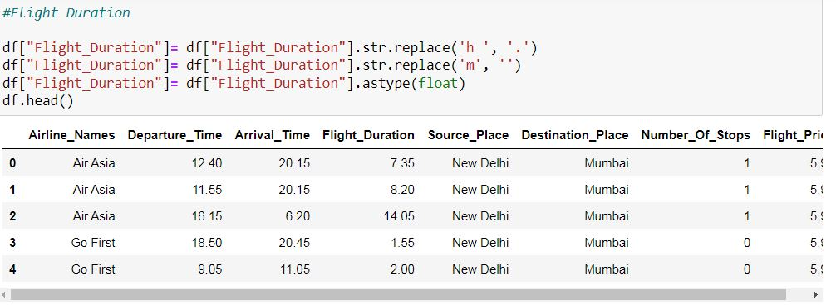

Slide 14
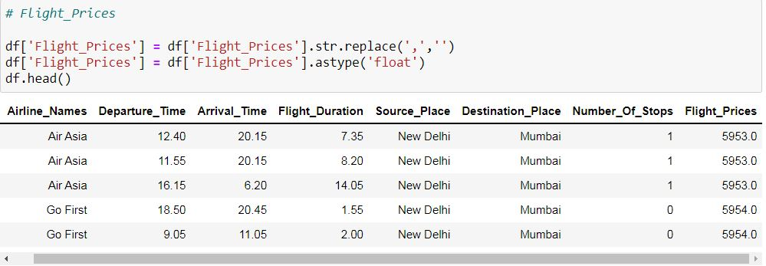

Slide 15
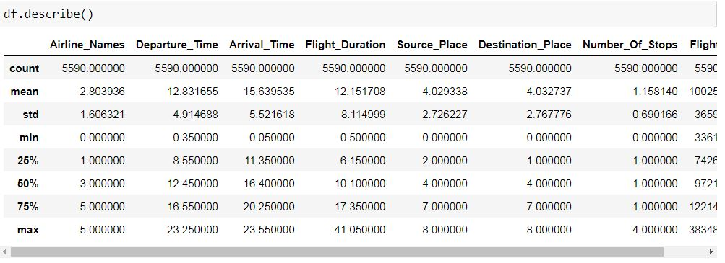
STATISTICAL SUMMARY
In descriptive statistics, summary statistics are used to summarize a set of observations, in order to communicate the largest amount of information as simply as possible. Summary statistics summarize and provide information about your sample data. It tells something about the values in data set. This includes where the average lies and whether the data is skewed.
The describe() function computes a summary of statistics pertaining to the Data Frame columns. This function gives the mean, count, max, standard deviation and IQR values of the dataset in a simple understandable way.

Slide 16
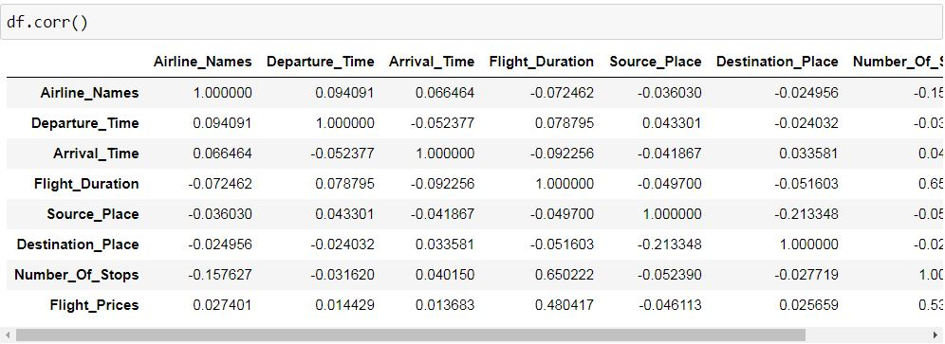
CORRELATION FACTOR
The statistical relationship between two variables is referred to as their correlation. The correlation factor represents the relation between columns in a given dataset.
A correlation can be positive, meaning both variables are moving in the same direction or it can be negative, meaning that when one variable's value increasing, the other variable’s value is decreasing.

Slide 17
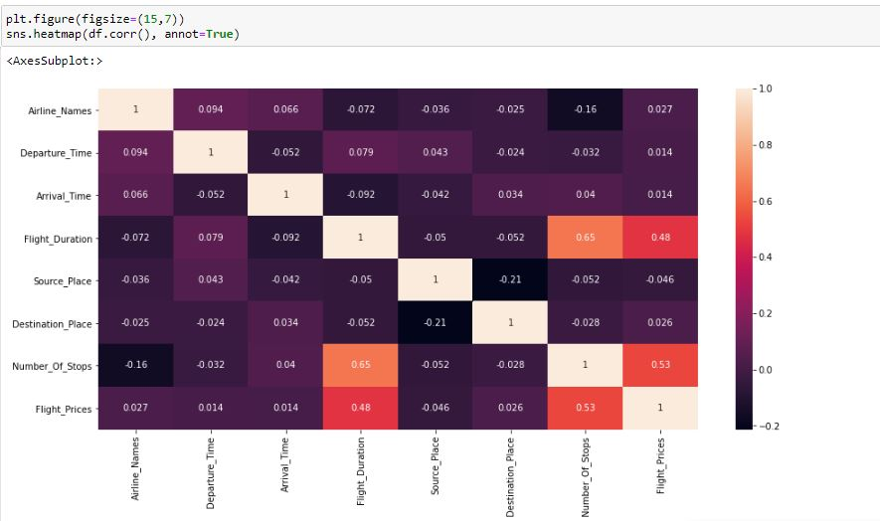
CORRELATION MATRIX AND ITS VISUALIZATION
A correlation matrix is a tabular data representing the ‘correlations’ between pairs of variables in a given dataset. It is also a very important pre-processing step in Machine Learning pipelines.
It is a data analysis representation that is used to summarize data to understand the relationship between different variables of given dataset.

Slide 18
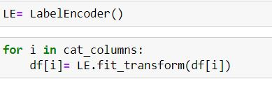
ENCODING NON-NUMERIC DATA USING LABEL ENCODER AND SKEWNESS REMOVAL
CHECKING SKEWNESS
Skewness refers to distortion or asymmetry in a symmetrical bell curve, or normal distribution in a set of data. Besides positive and negative skew, distributions can also be said to have zero or undefined skew. The skewness value can be positive, zero, negative, or undefined.

Slide 19
CHECKING OUTLIERS
An outlier is a data point in a data set which is distant or far from all other observations available. It is a data point which lies outside the overall distribution which is available in the dataset. In statistics, an outlier is an observation point that is distant from other observations.
A box plot is a method or a process for graphically representing groups of numerical data through their quartiles. Outliers may also be plotted as an individual point. If there is an outlier it will plotted as point in box plot but other numerical data will be grouped together and displayed as boxes in the diagram. In most cases a threshold of 3 or -3 is used i.e., if the Z-score value is higher than or less than 3 or -3 respectively, that particular data point will be identified as outlier.

Slide 20

TREATING SKEWNESS
Skewness can be treated in different ways.
Log Transform
Squareroot Transform
Power Transform
Box-cox Transform
Here we use power Transform to treat skewness.

Slide 21
HARDWARE AND SOFTWARE REQUIREMENTS AND TOOLS USED
For doing this project, the hardware used is a laptop with high end specification and a stable internet connection. While coming to software part, I had used anaconda navigator and in that I have used Jupyter notebook to do my python programming and analysis.
For using a csv file, Microsoft excel is needed. In Jupyter notebook, I had used lots of python libraries to carry out this project and I have mentioned below with proper justification:
1. Pandas- a library which is used to read the data, visualisation and analysis of data.
2. NumPy- used for working with array and various mathematical techniques.
3. Seaborn- visualization tool for plotting different types of plot.
4. Matplotlib- It provides an object-oriented API for embedding plots into applications.
5. zscore- technique to remove outliers.
6. skew ()- to treat skewed data using various transformation like sqrt, log, cube, boxcox, etc.
7. standard scaler- I used this to scale my data before sending it to model.
8. train_test_split- to split the test and train data.
9. Then I used different classification algorithms to find out the best model for predictions.
10. joblib- library used to save the model in either pickle or obj file

Slide 22
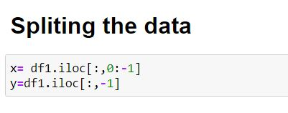
TESTING OF IDENTIFIED APPROACHES
After completing the required pre-processing techniques for the model building data is separated as input and output columns before passing it to the train_test_split.

Slide 23
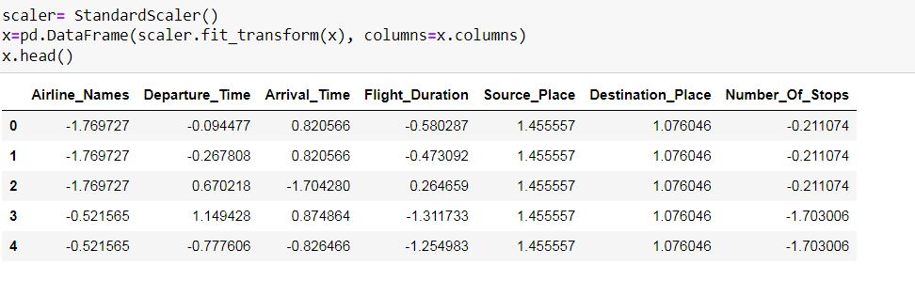
SCALING THE DATA USING STANDARD SCALER

Slide 24
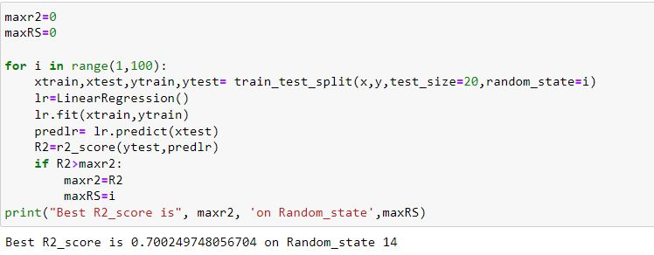
EVALUATE SELECTED MODELS
We will find the best Random State and C fold to run and evaluate the models.

Slide 25
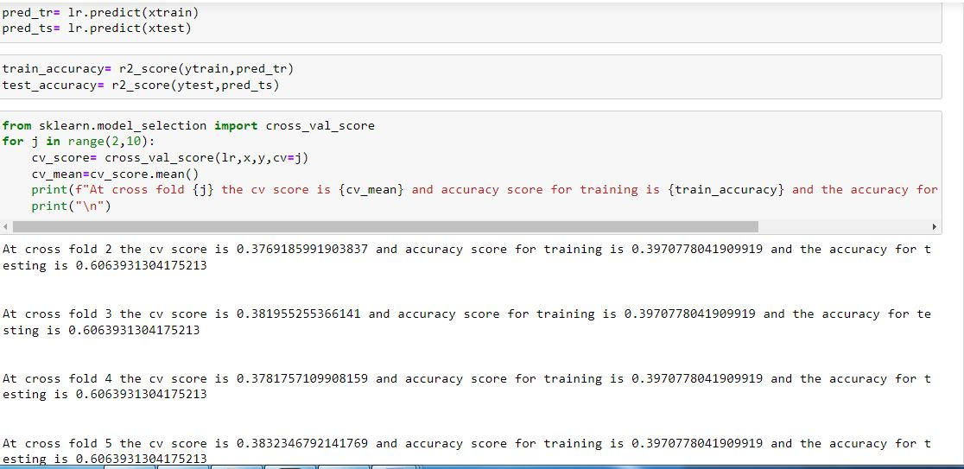

Slide 26
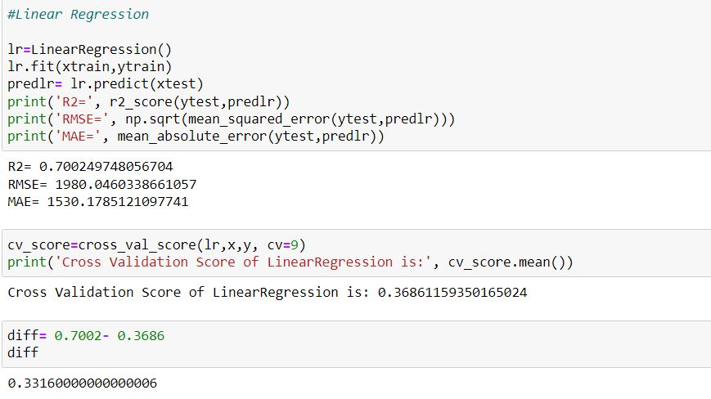
The best random state is found to be 14, cv=7. We shall run the other models with this random state and cv.
Linear Regression

Slide 27
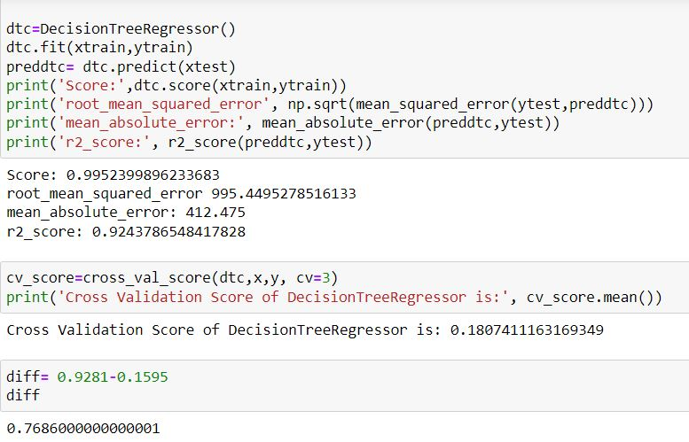
Decision Tree Regression

Slide 28
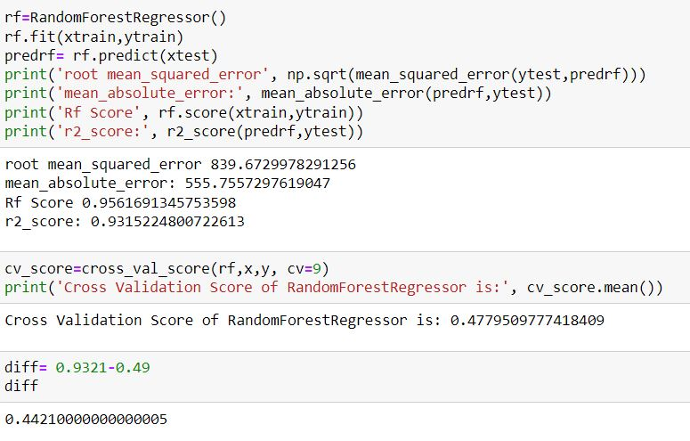
Random Forest Regression

Slide 29
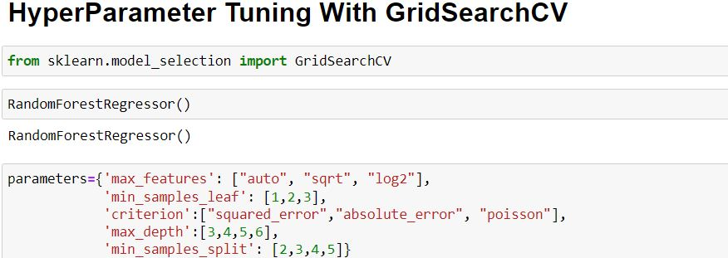
KEY METRICS FOR SUCCESS IN SOLVING PROBLEM UNDER CONSIDERATION
The key metrics used here were r2_score, cross_val_score, sd, MAE, MSE and RMSE. We tried to find out the best parameters and also to increase our scores by using Hyperparameter Tuning and we will be using GridSearchCV method.

Slide 30
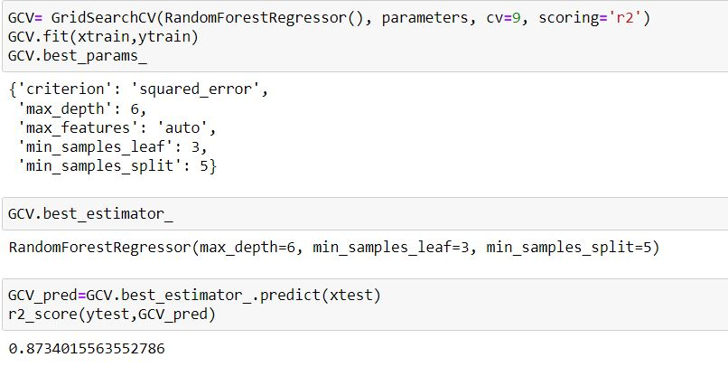

Slide 31
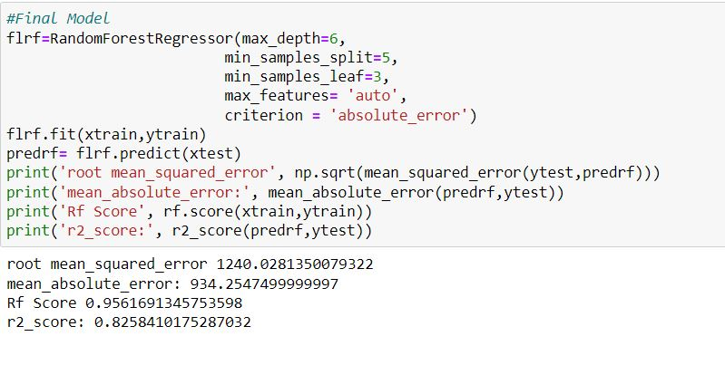
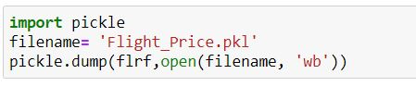
After tuning the Hyper parameters, we shall test it with our final model to get improved score of accuracy
After tuning the Parameters and the final model is saved for future reference.

Slide 32
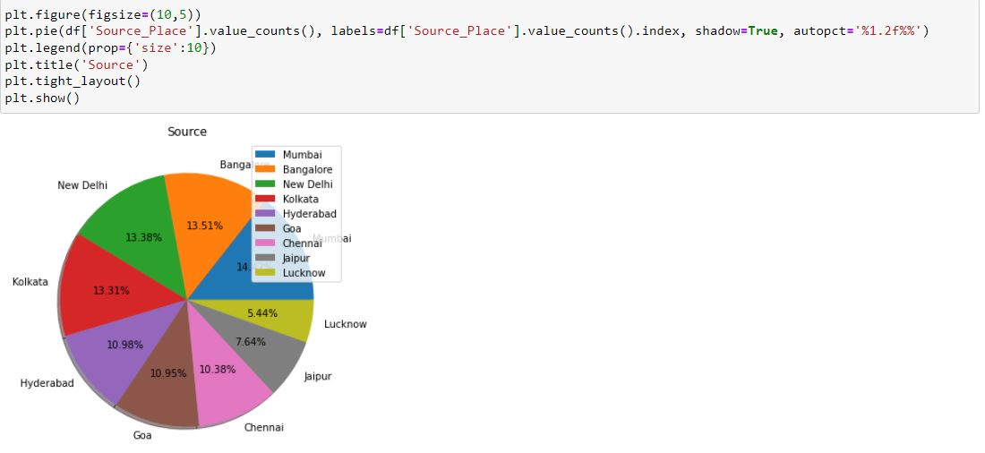
Visualizations

Slide 34
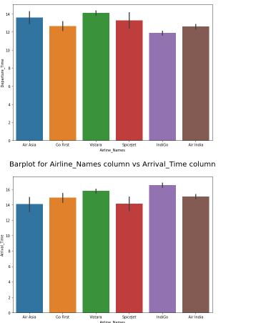
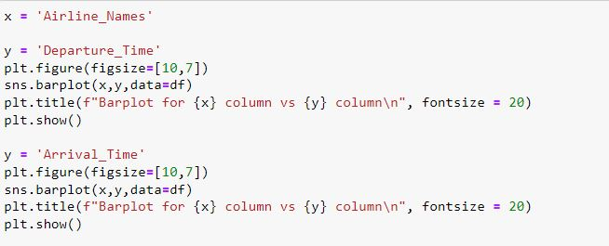

Slide 35
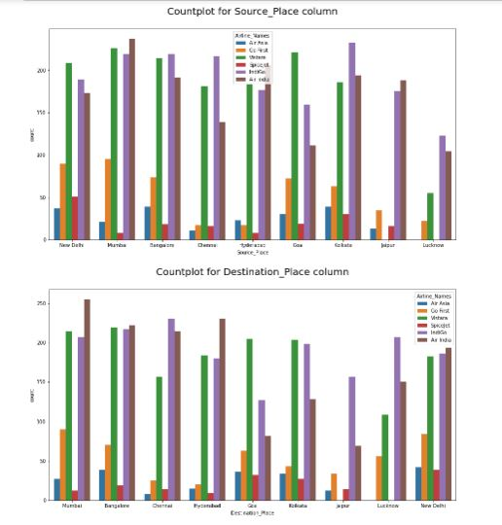
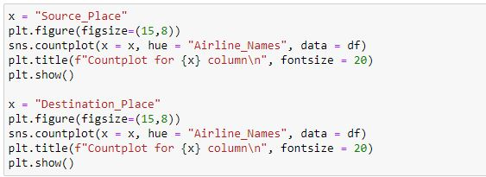

Slide 36
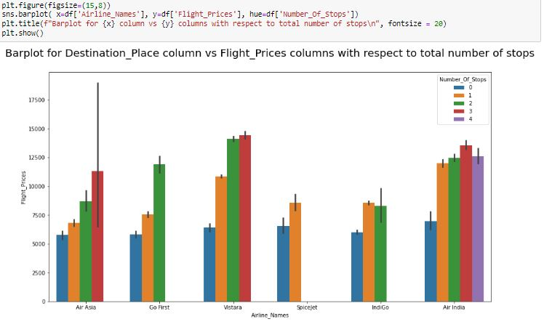

Slide 37
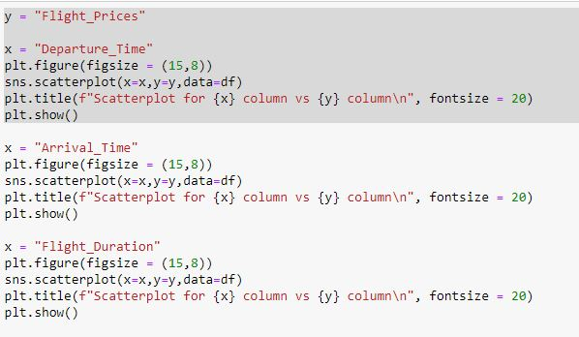
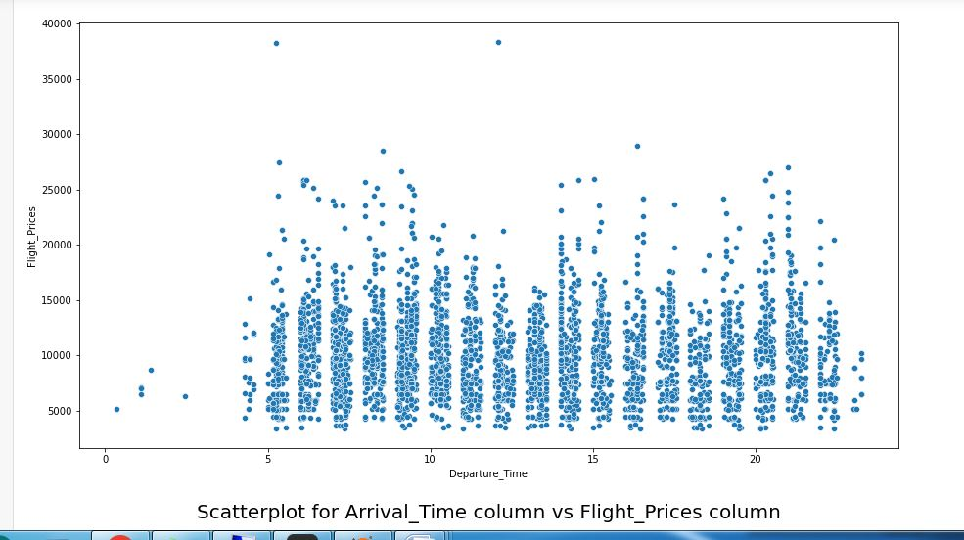

Slide 38
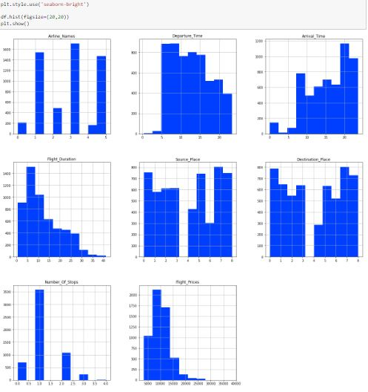

Slide 39
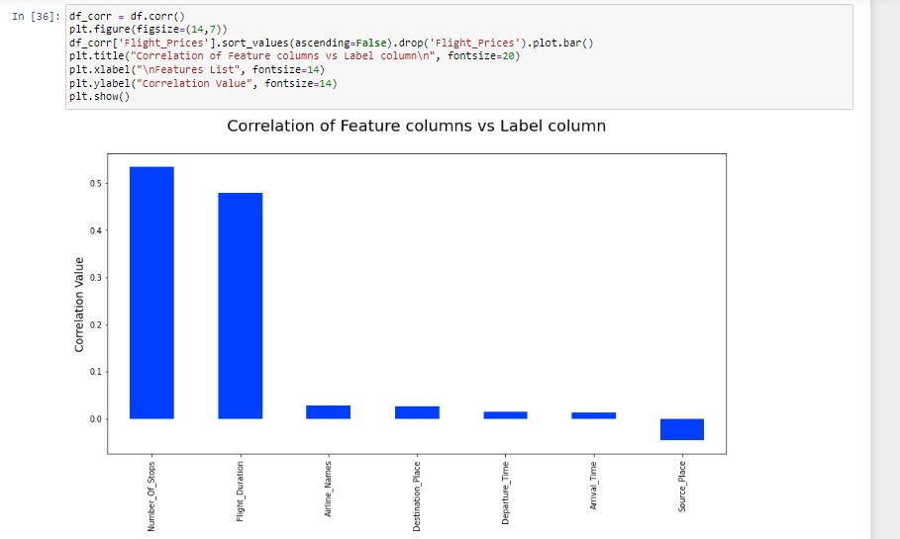

Slide 40
CONCLUSIONS OF THE STUDY
In this project we have scraped the flight data from airline webpages. Features like flight duration, number of stops during the journey and the availability of meals are playing major role in predicting the prices of the flights.
It could also help customers to predict future flight prices and plan the journey accordingly because it is difficult for airlines to maintain prices since it changes dynamically due to different conditions. Hence by using Machine Learning techniques we can solve this problem.
The above research will help our client to study the latest flight price market and with the help of the model built he can easily predict the price ranges of the flight, and also will helps him to understand Based on what factors the fight price is decided.

Slide 41
LEARNING OUTCOMES
Visualization part helped me to understand the data as it provides graphical representation of huge data.
It assisted me to understand the feature importance, outliers/skewness detection and to compare the independent-dependent features.
Data cleaning is the most important part of model building and therefore before model building, I made sure the data is cleaned.
I have generated multiple regression machine learning models to get the best model wherein I found Random Forest Regressor Model being the best based on the metrics I have used.

Slide 42
Limitations of this work
R2scores could have increased with more features. Some algorithms are facing over-fitting problem which may be because of a smaller number of features in our dataset.
Another limitation of the study is that in the volatile changing market we have taken the data, to be more precise we have taken the data after pandemic, it may change once stabilized and we have shortlisted and taken these data from the important cities across India. If the customer is from the different country our model might fail to predict the accuracy prize of that flight.

